Slide 1
Identifying Ideal Gym and Fitness Studio Locales
June 17, 2020

Slide 2
Problem Overview
Nearly 40% of adults in the United States are categorized as “obese”*
Gyms and active lifestyles are growing in popularity as a form of preventative self-care from the many adverse health effects of obesity.
Aim to recommend the optimal location(s) for a new Gym or Fitness Studio locale in Toronto.
* 2019 NHANES Report

Slide 3
Data Source & Cleansing
Venue statistics and features sourced from the Foursquare API.
The following venue features were queried and analyzed:
Check-in frequency & Trending
Unique visitors
Likes
Negative reviews
Gyms and Fitness studios were then analyzed and cleansed for relative proximity density: <500m, and areas with count=0 within 800m of each other.

Slide 4
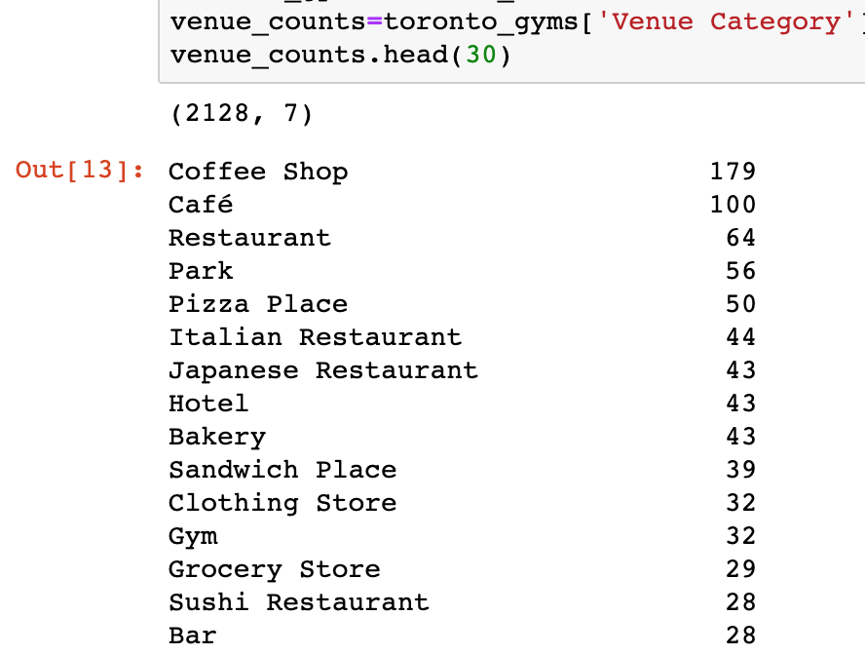
Result / Observation 1
We can see that Gyms are within the Top 15 venue categories in and around Toronto.
There are 32 ”Gyms” and 8 “Fitness Studios” in the Toronto region.
Next step in the analysis is to analyze proximity density between discrete locations.

Slide 5
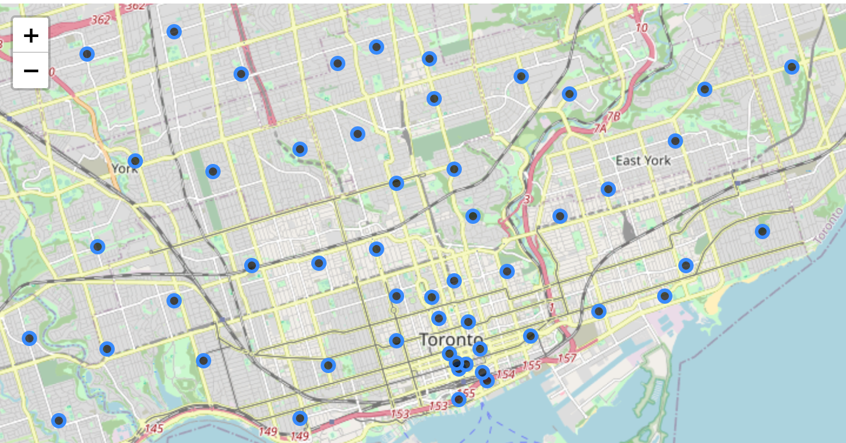
Result / Observation 2
There are 57 zones in total surrounding Toronto that fit our new fitness facility location criteria based on number of and distance to existing fitness facilities.

Slide 6
Conclusion
Through K-means clustering analysis, we were able to identify 57 “opportunity pockets” for optimal fitness facility location(s) in the Toronto region.
Further investigation is required into (non-exhaustive):
”Opportunity pocket” demographics
Relative affluence (would likely impact things like pricing, gym theme, etc.)
Population age
Any of the above-listed factors could influence or result in a non-ideal locale for a Gym or Fitness studio.

